Slide 1
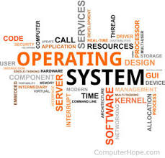
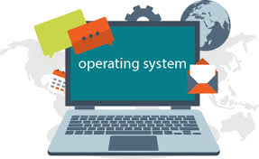
What is an Operating System ?
By Aaron Mascarenhas

Slide 2
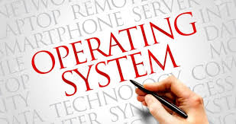
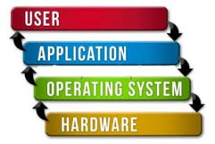
Operating System...
It is a software that allows users to communicate with the hardware.
It is an essential software which is required to perform basic low level programming.
It can be used to perform tasks such a scheduling tasks and controlling peripherals.

Slide 3
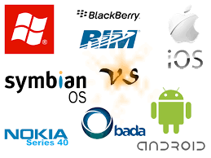
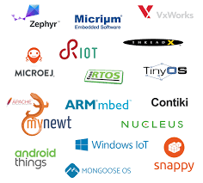
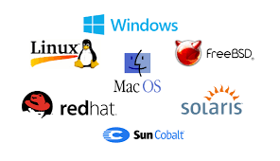
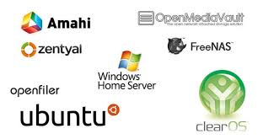
Types of Operating Systems...
Types of Operating Systems are -
Desktop Server/Network Mobiles Embedded Systems

Slide 4
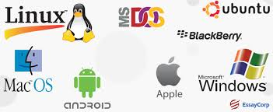
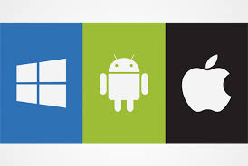
Purpose and Types of an Operating Systems
Types of OS in Desktop - acts as an intermediary between program.
Windows - 10,8.1,8,7,vista,Xp,ME,Windows 2000,98,95,MS-DOS
Mac - macos 10.14,10.13,10.12 OS X 10.10,9,8,7,6,5,4,3,2,1,0
Linux - Ubuntu, Arch Linux, Fedora, Ubuntu MATE, Kubuntu...
Unix - SunOS, Solaris, SCO UNIX, AIX, HP/UX, ULTRIX.
Types of OS in Server/Network - it provides service to the client.
Windows - Server 16,12,08,03,2000,NT
Mac - Mac OS X server 10.0,10.2,10.3,10.4,10.6,10.7,10.8,10.9
Linux - Ubuntu Server, openSUSE,oracle Linux, CentOS, Mageia
Unix - Ultrix, BSD unix, SCO unix, AIX, IRIX, Solaris
Types of OS in Mobiles - it provides a better interface for the user
Android OS - Oreo, Nougat, Marshmallow, Lollipop, Kitkat, jelly Bean
Apple iOS - iOS 5, iOS 6, iOS 7, iOS 8, iOS 9, iOS 10, iOS 11, iOS 12
Windows OS - Windows CE 1.0,2.0,Pocket PC 2000,2002,2003,5.0
BlackBerry OS - Classic, Passport, Priv, DTEK50, Motion, KEYone
Embedded Systems - integrated within the system
FreeDOS, Juno OS, Xinu, TinyOS, LynxOS, VxWorks, Palm OS, eCos

Slide 5
Hardware requirements of an Operating Systems in Desktops
Hardware Requirements of OS in Desktop -
Windows - 10
Processor : 1 gigahertz(GHz)
RAM : 1 gigabyte (GB) (32-bit) or 2GB (64-bit)
Hard Disk Space : 16 GB
Graphic Card : Microsoft DirectX 9 graphics device with WDDM driver.
Mac - 10
Processor : 2 GHz Intel Core i5 (OS X 10.8 or later)
RAM : 2GB of memory
Hard Drive Space : 12.5 GB of available storage (OS X El Capitan 10.11.5 or later)
Graphic Card : Mac Pro ( Mid 2010) and Mac Pro (Mid 2012)
Linux - Ubuntu
Processor : 2 Ghz dual core processor
RAM : 2 GB (system memory)
Hard Drive Space : 25 GB of hard drive space
Graphic Card : 3D Acceleration, Video-card with at least 256 MB.
Unix - AIX
Processor : Configured POWER5 or later (64-bit)
RAM : 2GB
Hard Drive Space : 7.5GB

Slide 6
Hardware requirements of an Operating Systems in Server/Networks
Hardware requirements of OS in Server/Networks -
Windows Server-
Small installation (<1k entries, 1-10 users):
Processor : Dual-Core 1.6 Ghz or higher
RAM : 2 GB RAM
Hard Disk Space : 500 MB free disk space
Info.pleasantsolutions.com. (2018). Hardware and Software Requirements - Pleasant Solutions. [online] Available at: https://info.pleasantsolutions.com/Documentation/Pleasant_Password_Server/A._Install_Pleasant_Password_Server/Hardware_and_Software_Requirements [Accessed 15 Dec. 2018].
Mac Server-
Processor: 64-bit intel processor,core 2 duo
RAM : 2 GB
Hard drive space: 8GB of free hard drive space.
dummies. (2018). Hardware Requirements for Running Lion Server - dummies. [online] Available at: https://www.dummies.com/computers/macs/mac-operating-systems/hardware-requirements-for-running-lion-server/ [Accessed 15 Dec. 2018].

Slide 7
Hardware requirements of an Operating Systems in Server/Networks
Hardware requirements of OS in Server/Networks -
Linux - Ubuntu Server -
Processor : 300 MHz x86
RAM : 256 MiB of system memory
Hard Drive : 1.5 GB of disk space
Graphic Card :
ATI (some may require the proprietary fglrx driver)
Intel (i915 or better, except GMA 500, aka "Poulsbo")
NVidia (with their proprietary driver)
Help.ubuntu.com. (2018). Installation/SystemRequirements - Community Help Wiki. [online] Available at: https://help.ubuntu.com/community/Installation/SystemRequirements [Accessed 15 Dec. 2018].
UNIX Server - Minimum Requirement
Processor : ESM manager+agent - 2.8 GHz, ESM agent - 1.33 GHz
RAM : ESM manager+agent - 2 GB, ESM agent - 512 MB
Hard Drive : ESM manager+agent - 25 GB, ESM agent - 450 MB
Swap space : ESM manager+agent - 4 GB, ESM agent - 1 GB
Network speed : ESM manager+agent - 100 Mbps, ESM agent - 10Mbps
Support.symantec.com. (2018). System requirements for UNIX computers. [online] Available at: https://support.symantec.com/en_US/article.HOWTO49976.html [Accessed 15 Dec. 2018].

Slide 8
Hardware requirements of an Operating Systems in Server/Networks
Hardware requirements of OS in Mobile -
Minimum hardware requirement Android OS -
Processor : 200 MHz, ARMv4 or higher (ARMv5 needed to run native code without modification)
RAM : 32 MB
Storage : 32 MB
Android Enthusiasts Stack Exchange. (2018). What are the minimum hardware specifications for Android?. [online] Available at: https://android.stackexchange.com/questions/34958/what-are-the-minimum-hardware-specifications-for-android [Accessed 15 Dec. 2018].
Apple iOS -
Processor : Intel Core 2 Duo, Core i3, Core i5, Core i7, or Xeon processor
RAM : 2 GB
Storage : 7 GB
Apple Support. (2018). System requirements for OS X Lion and Mac OS X v10.6. [online] Available at: https://support.apple.com/en-us/HT202328 [Accessed 15 Dec. 2018].
Windows OS -
Processor : 32-bit edition of Windows 10
RAM : 512 MB for windows 8.1, 4 GB for windows 10
Storage : 4 GB with SD card to facilitate future updates
Windows Central. (2018). Microsoft sheds light on minimum hardware requirements for Windows 10 for phones and desktops. [online] Available at: https://www.windowscentral.com/microsoft-lists-minimum-hardware-requirements-windows-10-phones-and-desktops [Accessed 15 Dec. 2018].
Blackberry OS -
Processor : 5 GHz dual core
RAM : 2 GB
Storage : 16 GB
NDTV Gadgets 360. (2018). BlackBerry Z10 price, specifications, features, comparison. [online] Available at: https://gadgets.ndtv.com/blackberry-z10-24 [Accessed 15 Dec. 2018].

Slide 9

What are the Key Features of an Operating System ?

Slide 10
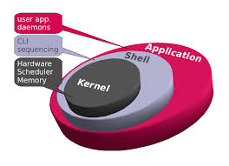
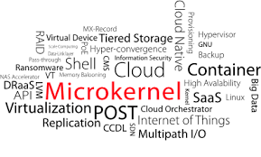
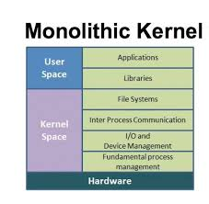
Features of an Operating System...
Kernel -
Most important part as it helps in the operating system
Providing services for different parts of the systems.
Loads up with the operating systems boots up, and
Performs low end tasks which control the disk management, memory management, and task management as the kernel run in the the background.
Microkernel -
This part of the keral is responsible for memory management, multitasking, and interprocess communications .
Used by the hardwares that provide these services.
Monolithic Kernels -
This part of the kernel boots along with main operating system,
Provides more power to the hardware in the same memory area as the kernel thread

Slide 11
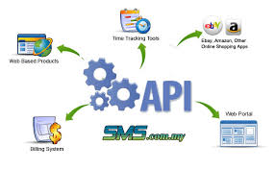
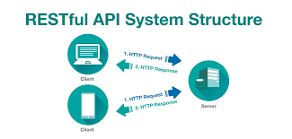
Features of an Operating System...
API -
API stands Application Programming Interface, It is built for customers other organisations.
Set of functions and commands, which are used to create softwares.
For windows the API, consist of dialog box, windows, scrollbars for the developers with user interface.

Slide 12
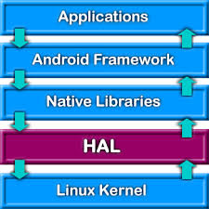

Features of an Operating System...
HAL-
HAL is termed as Hardware abstraction layer, which helps interact with hardware devices.
In Windows 2000, it includes a hardware abstraction layer.
The operating system’s kernel or device drivers can call the hardware abstraction layer.

Slide 13

What are the Services of an Operating System ?

Slide 14


Services of an Operating System...
File Management -
Operating system helps in managing files and organizing them in separate folders where the CPU can locate it easily.
Provides user interface -
Users can easily interact with the system as the operating system allows them to do so with simple to use interface.
Hardware Adaptability-
It can adapt to different hardware system without causing any problems to the CPU and is compatible with various systems.
Memory Management -
Operating system manages memory by allocating different memory segments to carry out specific tasks properly.
Task Management -
It manages task by distributing the workload to limited amount of memory in the CPU to run a smooth as possible without any issues to the system itself.

Slide 15




Services of an Operating System...
Memory Management -
Memory is used by different programs which run in the background alongside other activities, if there was no operating system in place the programs may not be able to run properly.
Disk Management -
The Disk is managed by the operating system which takes care of the disk usage and stored files and folders in an efficient manner..
Booting -
The operating system takes care of the start-up by going through the booting process which sets up the pc to make it usable.
Device Controlling -
The operating system controls the device by setting up drivers to be able to use it when necessary, It organises the devices into groups.
Process Management -
The operating organises the task by giving priority to tasks which require more CPU usage, if there are too many tasks, it calculates the task which requires the CPU.
Loading and Execution -
Before the program can be launched, it has to be stored into the memory before it can be initialised, this is where the operating system comes in to load the programs which is done into the memory by ease and then launched.
Data Security -
The data is the most essential part of an computer system, to protect the data which is stored from any modifications and deletions is done by the operating system.
Providing Interface -
The interface is provided by the operating system which allows users to interact with the CPU by displaying outputs on to the screen.

Slide 16


Analysis of services by an Operating System
User Interaction -
The Operating system provides services by having a user interface, when the user gives instructions to the Operating system it responds by giving and output that displays the message.
Memory Management -
It helps to manage background processes while performing multiple tasks at the same time which is efficient in an operating system.
File Management -
This helps the operating system to store data and organise them according to their functions by separating them into different files.
Hardware Support -
Operating systems supports all hardware as it would be very efficient to switch to different hardwares without having to change to a different OS completely while keeping previous settings.

Slide 17
Summary -
What is an Operating Systems
Types of Operating Systems
Purpose, use and hardware requirements of an operating system
Features of an Operating System
Service of an Operating System
Analysis of services by an operating system

